Slide 1
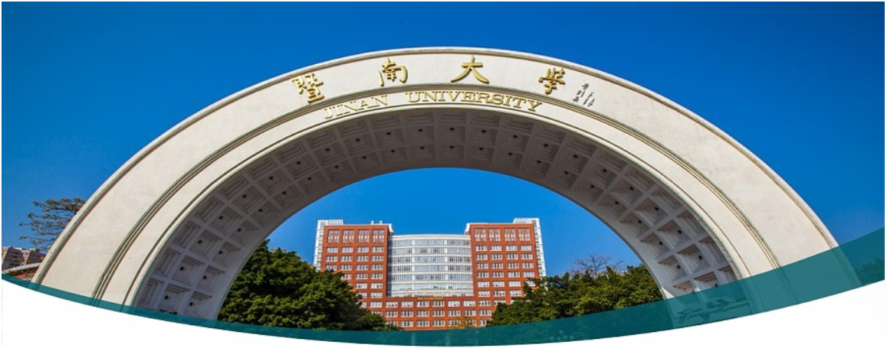

Machine Learning 1. Introduction
Xueyuan Gong
School of Intelligent Systems Science and Engineering

Slide 2
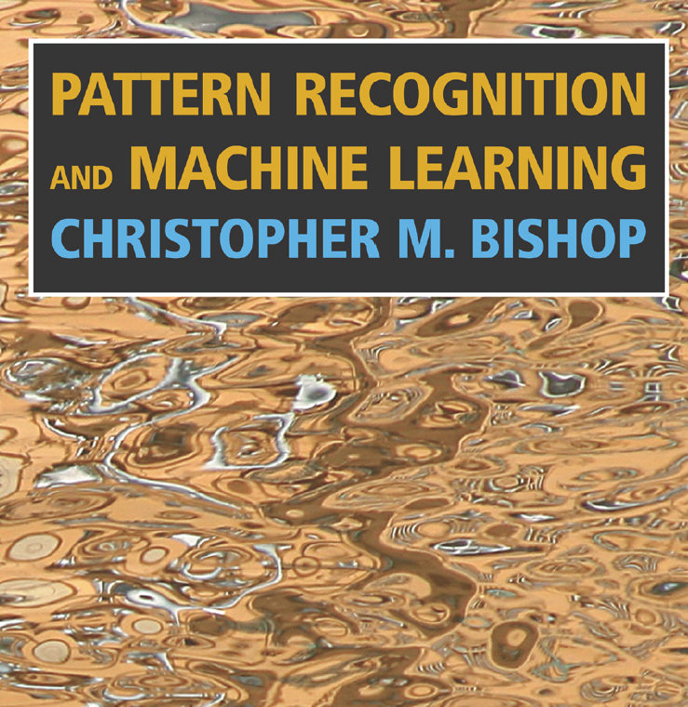
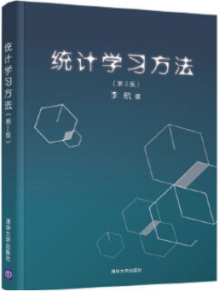
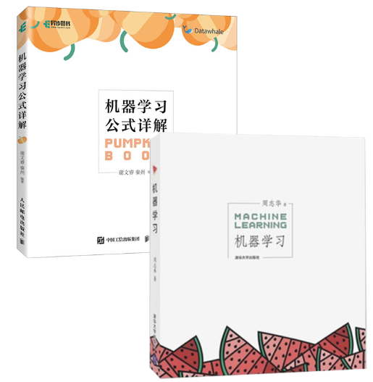
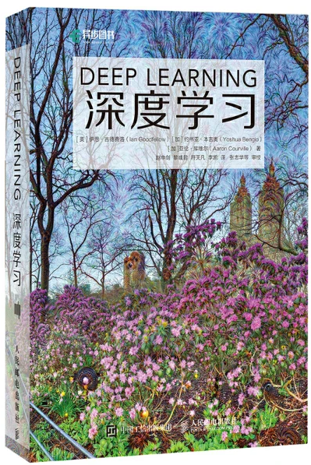
Books
Text book
Pattern Recognition and Machine Learning, Christopher M. Bishop, Springer
Reference book
机器学习（西瓜书），周志华，清华大学出版社
机器学习公式详解（南瓜书），谢文睿，人民邮电出版社
统计学习方法，李航，清华大学出版社
Deep learning （花书）, Ian Goodfellow, 人民邮电出版社

Slide 3
Schedule
Ch1: Introduction | Ch10: Perceptron
Ch2: Numpy | Ch10: Support Vector Machine
Ch3: Optimization | Ch11: Support Vector Machine
Ch4: Linear Regression | Ch12: Decision Tree
Ch5: Logistic Regression | Ch13: Ensemble Learning
Ch6: Model Selection | Ch14: Clustering
Ch7: Regularization | Ch15: Reinforcement Learning
Ch8: Softmax Regression | Ch17: Review
Ch9: Neural Networks | Ch18: Review

Slide 4
Grading
Attendance: 10%
Homework: 30%
Final exam: 60%
Total = Attendance + Homework + Final exam

Slide 5
Prerequisite
Math
Calculus
Linear algebra
Probability and statistics
Programming
C/C++
Python
Data structure
Algorithm

Slide 6
Extracurricular Materials
Andrew Ng
Homepage: https://www.andrewng.org/
Machine Learning: https://www.deeplearning.ai/courses/machine-learning-specialization/
Deep Learning: https://www.deeplearning.ai/courses/deep-learning-specialization/
Hung-Yi Lee
Homepage: https://speech.ee.ntu.edu.tw/~hylee/index.php
Machine Learning: https://speech.ee.ntu.edu.tw/~hylee/ml/2022-spring.php
They contribute a lot to my slides

Slide 7
Artificial Intelligence vs. Machine Learning
No exact definition for them
ML is a subset of AI
As long as something own intelligence since humans, it is AI
As long as something can learn by itself, it is ML
Defined by me

Slide 8
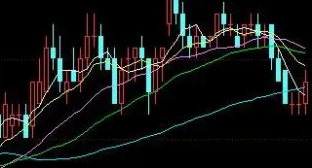
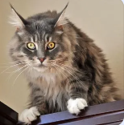
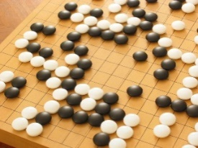
Machine Learning ≈ Looking for a Function
Stock Price Prediction
Image Recognition
Playing Go
“28.5”
“Cat”
Is human a kind of function???
“5-5”

Slide 9
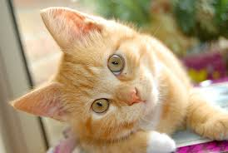
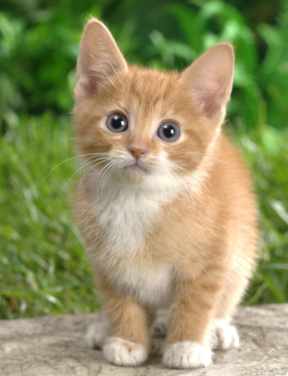

Framework
Image Recognition:
“cat”
A set of function
Model
“cat”
“money”
“dog”
“snake”
Notes:
Repeat again

Slide 10
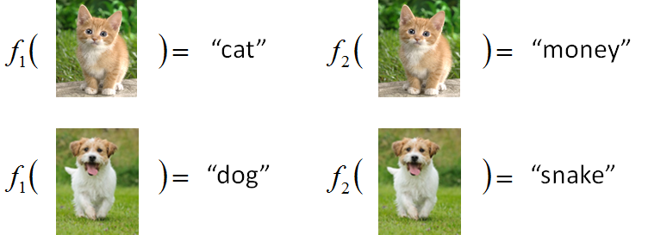
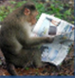
Framework
Image Recognition:
“cat”
A set of function
Model
Better!
Goodness of function f
Training
Data
function input:
function output:
“monkey”
“cat”
“dog”
Notes:
Repeat again

Slide 11
Framework
Image Recognition:
“cat”
A set of function
Model
Training
Testing
“cat”
Step 2
Goodness of function f
Pick the “Best” Function
Using
Step 3
Step 4
Training
Data
Step 1
“monkey”
“cat”
“dog”
Notes:
Repeat again

Slide 12

Paradigm of Machine Learning
Unsuitable Pokemon
Dataset
Model
Loss
Optimization
Step 1:
Prepare
training
data
Step 2:
Define
a set of
functions
Step 3:
Define the
goodness of functions
Step 4:
Find a way to pick the best function
Inexperienced trainer
There are exceptions, e.g. Zero-shot Learning
AI trainer
Pick up the model, the loss, and the optimizing algorithm
Experienced trainer is required
Pokemon trainer
Pick up the suitable Pokemon
Experienced trainer is required

Slide 13
Categories of Machine Learning
No exact category
Supervised Learning
Regression
Classification
Unsupervised Learning
Clustering
Dimensionality reduction
Ensemble Learning
Reinforcement Learning
Yet, we have a lot more others
Few-shot Learning
Long-tailed Learning
Zero-shot Learning
Life-long Learning
Generative Adversarial Learning
Transfer Learning
Meta Learning
Federated Learning
…
Deep networks, i.e. Deep Learning

Slide 14
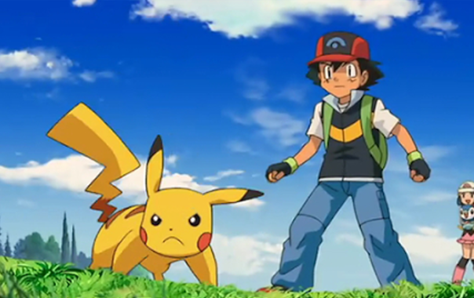
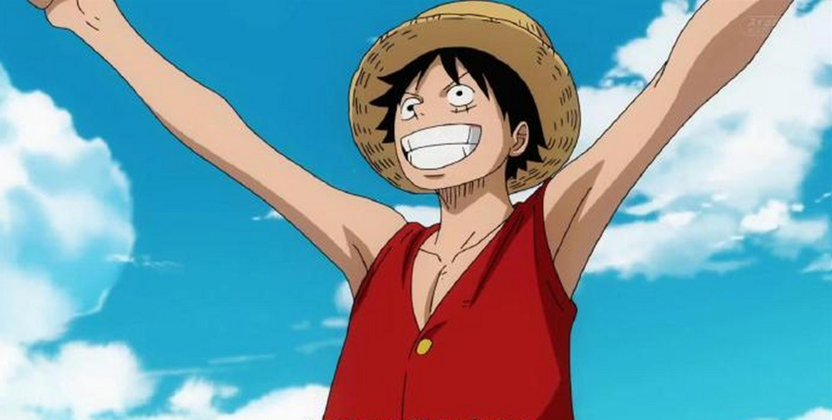
Head towards training masters
以宝可梦训练大师为目标迈进吧！
我是要成为航海王的男人/女人！

Slide 15
Thank you！

